Slide 1
Expression Trees in C#
Microsoft .NET Singapore Meetup
22-Jan-2019

Slide 2
About Me
Enterprise integration, database, and application development
Occasional contributor to open source .NET projects
Recently getting my feet wet in React, JavaScript, and Typescript
Upcoming interesting stuff
DevOps implementation on Azure
Migration of B2B functions to Azure serverless

Slide 3
Agenda
What are expression trees (DLR)
Why use expression trees
Some example uses (Iron Python, linq)
How to create expression trees
Lambda
API
Primitive expressions, control flow, variable assignment,
Demo – create one using lambda and another using API
Our use case – Object factory

Slide 4
Quote
“Starting January 2019 the .NET Community Singapore and Azure Community Singapore will be focusing on Machine Learning and AI (Artificial Intelligence) topics”
~ Riza

Slide 5
What Expression Tree?
Represents
As Tree-like data structure
Created using
Resulting to
int Square(int x) { return x * x; }
Lamba Expression
Delegate
Func<int, int>
Parameter:
Name: “x”
Type: int
Body: Multiply Expression
or
or
Expression API
Domain specific language (DSL)
Left Expression:
Parameter “x”
Right Expression:
Parameter “x”
Notes:
DSL – EF has Iqueryable as an example

Slide 6
Expression Trees… Why?
I need to evaluate my DSL at runtime
I want to avoid typing tedious code… bleh!
I need to construct DSL at runtime
(example: EF providers implementing IQueryable)
(example: IronPython)

Slide 7

Quick history
Released as part of .NET 3.5 with restricted support for expressions
API expanded to support control flow and assignments in .NET v4. Expression trees are one of the ingredients for .NET’s Dynamic Language Runtime (DLR)
Supported in .NET Standard 1.0
Hangfire
Notes:
DSL – EF has Iqueryable as an example

Slide 8
Create using Lambda Expressions
Sample Code
Expression<Func<int, int>> squareExpr = x => x * x;
It’s easy to use but….
Only supports single-line lambdas
This will not work
Expression<Func<int, int>> squareExpr = x =>
{
Console.Writeline("Look, two statements!");
return x * x ;
}

Slide 9
Create using Expressions API
The possibilities!
Expressions
Parameter
Constants
Mathematical Operations
Logical Operations
Comparison Operators
Statements
Variable creation
Assign
Dynamic
Throw exceptions
Control Flow
If-Else
Loops
Switch
Try-catch
Break

Slide 10
DEMO
dotnet add package AgileObjects.ReadableExpressions
dotnet add package Shouldly

Slide 11
Let’s solve a real problem
We are building
Workflow application with a common RESTful interface
Technical Requirement
GIVEN the workflow name and data parameters, WHEN the workflow is triggered THEN convert data parameters into the workflow’s data type and create an instance of the workflow
Notes:
DSL – EF has Iqueryable as an example

Slide 12
Let’s solve a real problem
{
‘workflowName’: “LeaveApproval”,
‘dataParams’: [
{ ‘EmployeeId’: ‘3434’},
{ ‘LeaveStart’: ‘2019-09-15T00:00:00’},
{ ‘LeaveEnd’: ‘2019-09-16T00:00:00’}
]
}
Class LeaveApprovalData
{
public int EmployeeId {get;set;}
public DateTime LeaveStart {get; set;}
public DateTIme LeaveEnd {get; set;}
}
var data = new LeaveApprovalData
{
EmployeeId = 3434,
LeaveStart = new DateTime(2019,09,15),
LeaveEnd = new DateTime(2019,09,16)
};
Workflow.Start(“LeaveApproval”, data);
Notes:
DSL – EF has Iqueryable as an example

Slide 13
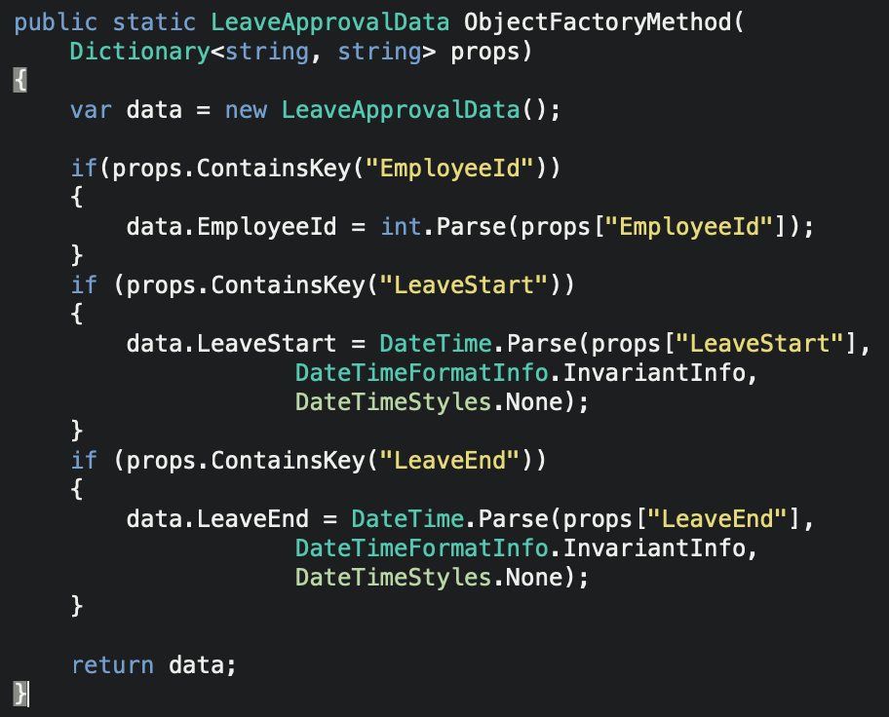
We need to generate this
Parameter Expression
Variable Expression
Constant Expression
New Expression
Conditional Expression
Block Expr
Call Expression
Member Expression
Assignment Expression
Notes:
DSL – EF has Iqueryable as an example

Slide 14
DEMO
dotnet add package AgileObjects.ReadableExpressions
dotnet add package Shouldly

Slide 15
Tools
Readable Expressions (NuGet) to display - https://www.nuget.org/packages/AgileObjects.ReadableExpressions
http://community.bartdesmet.net/blogs/bart/archive/2009/08/10/expression-trees-take-two-introducing-system-linq-expressions-v4-0.aspx

